Slide 1
Capstone Project - 2
Team 2
Taxi Mobility Surge Price Prediction
Team Members
Bhanu Pratap Shahi
Sanchita Paul
Shubham Kumar
Sumanta Muduli

Slide 2
Content
pTHeyOlem
Title
Problem Statement Data Summary Comparing features with Surge Pricing Type Feature Selection Models used Which model did we choose and why? Challenges Conclusion

Slide 3
Problem Statement
OP
The goal is to build a predictive model which can help Sigma Cabs in predicting Surge Pricing Type proactively.
This will help them in matching the right priced cabs with the right customers quickly and efficiently.

Slide 4
Data Summary:
Data set name Data Sigma Cabs
Shape
Rows -- 131,662
Columns--14
Features
Trip_ID,Trip_Distance,Type_of_Cab,Customer_since_months, Life_Style_Index, Confidence_Life_Style_Index,Destination_Type, Customer_Rating,Cancellation_Last_1Month,Var1,Var2,Var3,Gender, Surge_Pricing_Type

Slide 5
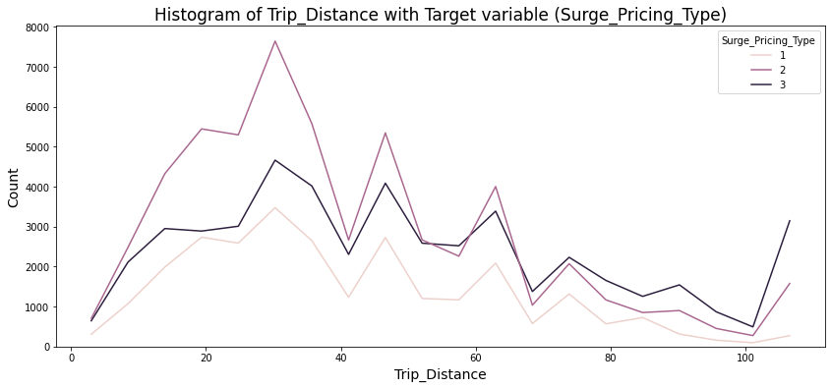
Comparing Trip Distance with Surge Pricing Type:

Slide 6
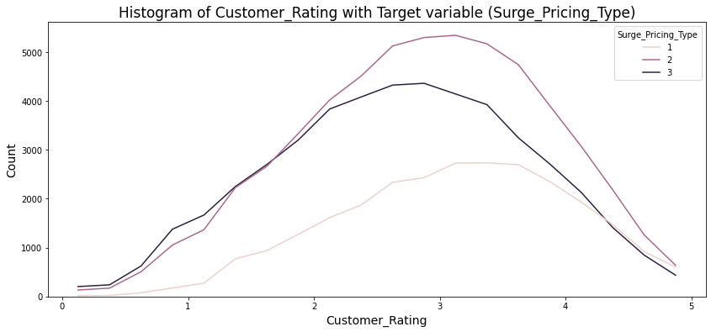
Comparing Customer Rating with Surge Pricing Type:

Slide 7
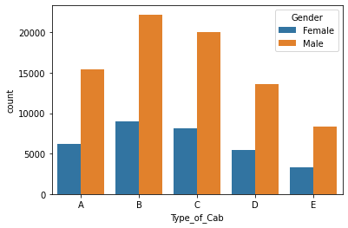
Count of Type of Cab with Gender Filter

Slide 8
Features selection:
Methods used:
Extra Tree Classifier
ANOVA
Chi-Square

Slide 9
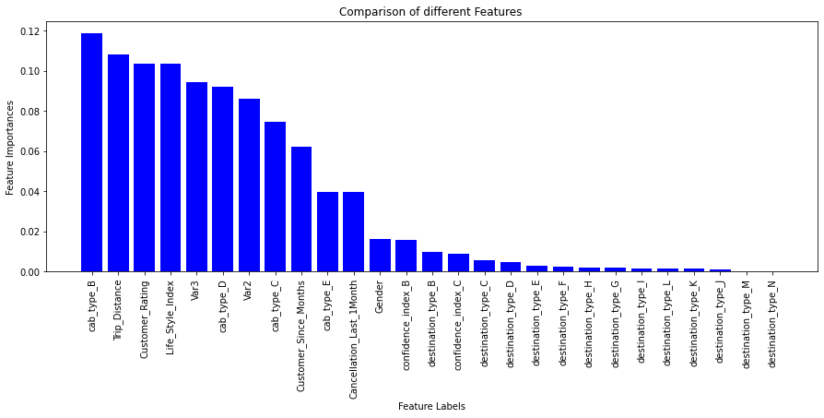
Extra Trees Classifier:

Slide 10
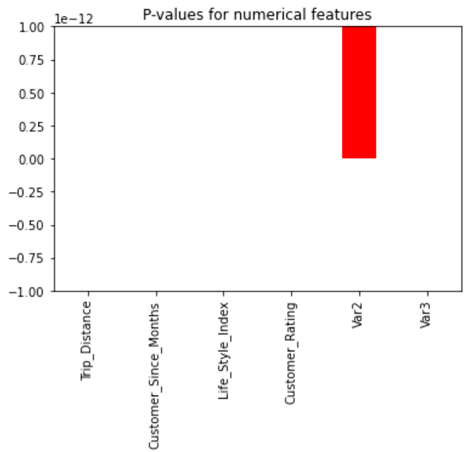
ANOVA:

Slide 11
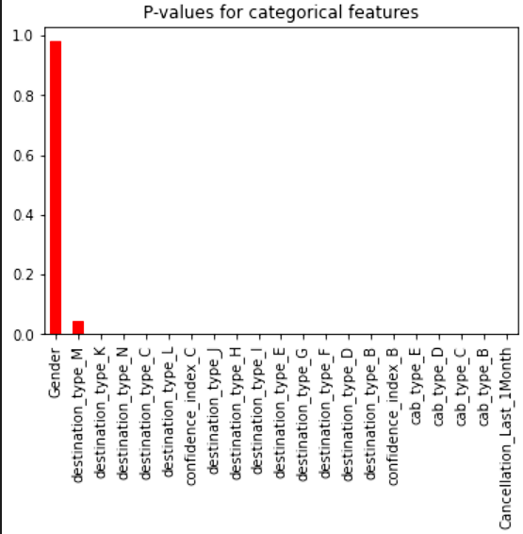
Chi-Square:

Slide 12
Models used:
Logistic Regression Classifier
SVM Classifier
Random Forest Classifier
XGBoost Classifier

Slide 13
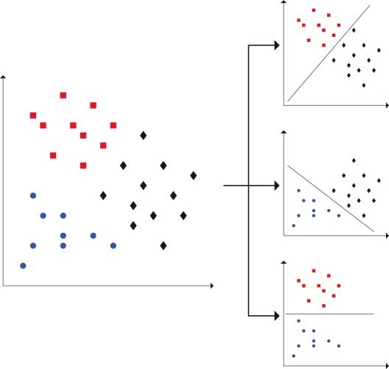
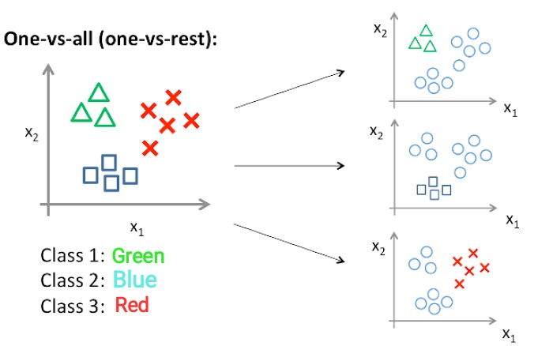
One vs One and One vs Rest:
R Vs B
B Vs B
R Vs B
One vs One
One vs Rest

Slide 14
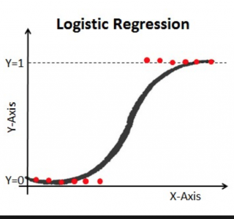
Logistic Regression:
One vs Rest approach (“ovr”)
Hyperparameter Tuning( Bayesian Optimisation)-C:0.001, solver:”lbfgs”,penalty=l2
Metric Scores- Accuracy=72%, Precision=72%, Recall=70% & f1_score=71%

Slide 15
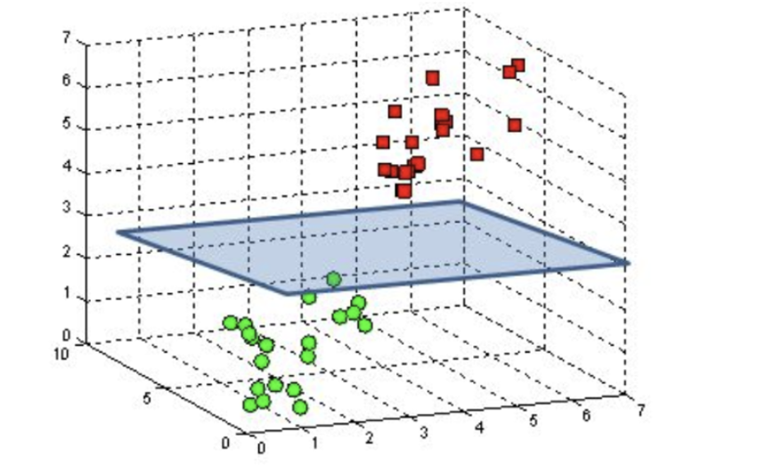
Support Vector Machine:
One vs One approach (“ovo”)
Parameters - C:1, degree =3,
Kernel - Poly Kernel is giving us the best results. Accuracy i.e 72%, Precision=73%, Recall=70% & f1_score=70%

Slide 16
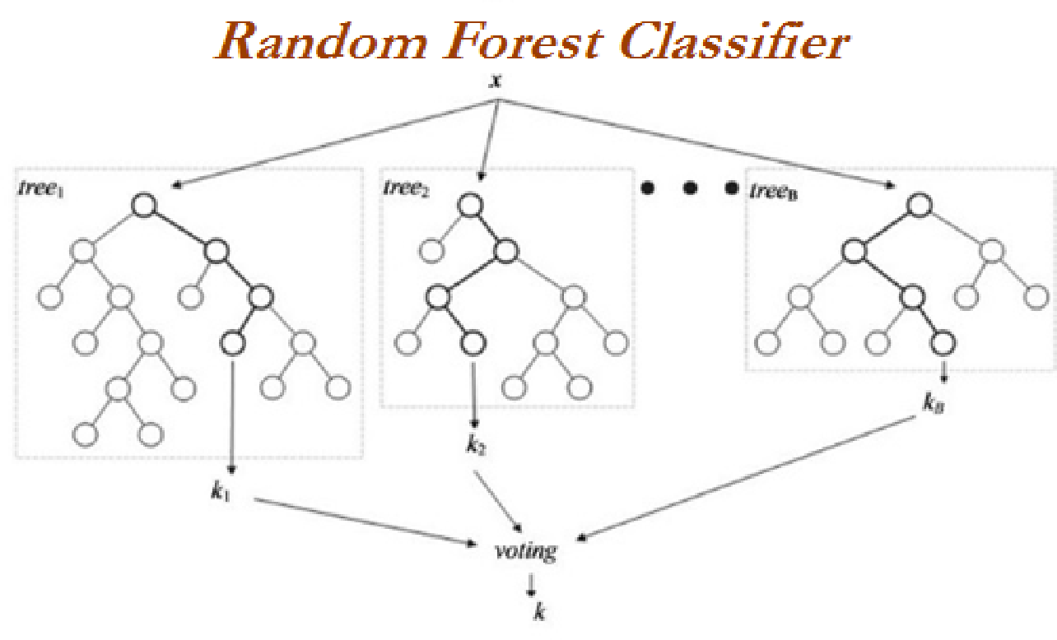
Random Forest Classifier:
Hyper parameter Tuning(Bayesian Search)-
('max_depth', 8),
('min_samples_leaf', 10), ('min_samples_split', 50),
('n_estimators', 100)
accuracy= 72%,
precision=73%, recall=70%,fi_score=71%

Slide 17
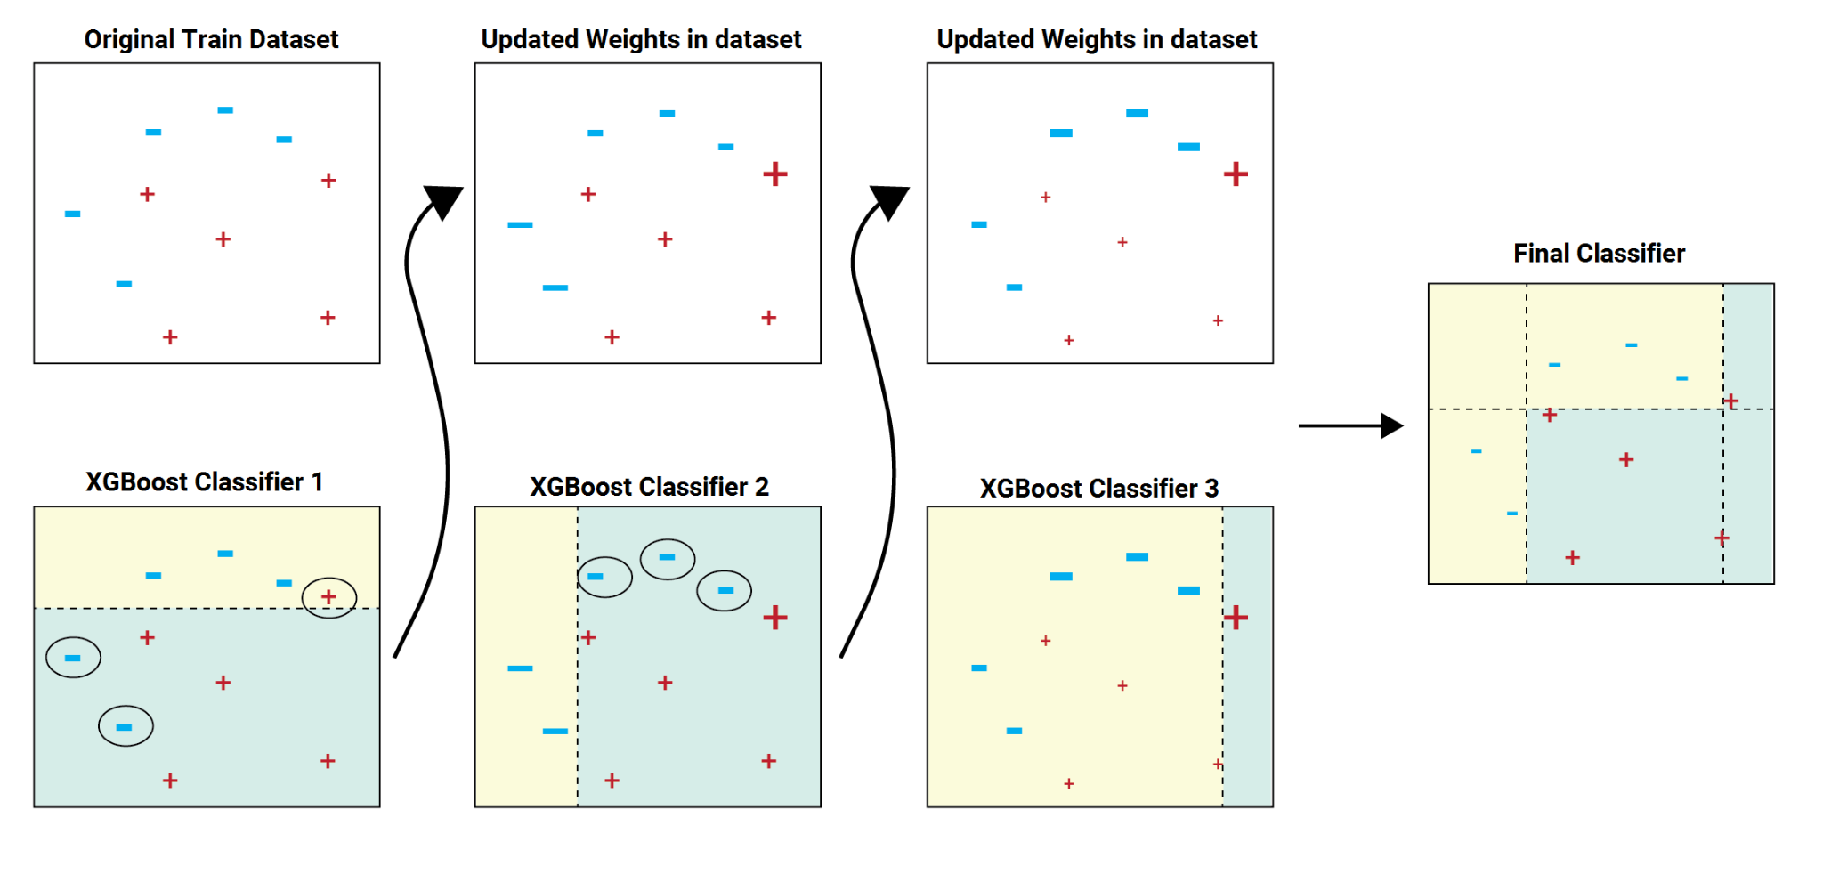
XGBoost Classifier:
Hyperparameters-gamma=0, learning_rate=0.1,
max_depth=15, n_estimators=100, objective='multi:softprob'
Metric Scores- accuracy=72%, precision=73%, recall=70%,f1_score=71%

Slide 18
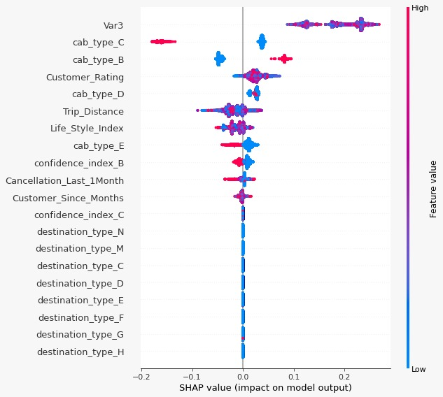
SHAP Values:

Slide 19
Which model did we choose and why?
We choose logistic regression as it’s evaluation scores is very similar to other complicated models but it is computationally cheaper and more interpretable.
Accuracy : 72%
Recall : 72%
Precision : 72%
This is the most consistent performing model with same scores for all metrics.

Slide 20
Challenges
Lots of NaN values in the dataset.
Some features like Var1,Var2,Var3 are not clearly explained.
Choosing the right encoding technique for categorical features.
Choosing the right features for modelling.
Faced issues while running the models as the dataset is large.
Choosing the right models as there is not much difference in accuracy.

Slide 21
Conclusion
We build a predictive model which can help Sigma Cabs in predicting Surge Pricing Types proactively.
This will helps in matching the right cab with the right customer quickly and efficiently
They can increase their customer base and profit by providing better services.

Slide 22
Q & A

